Slide 1
How were the yeast cells extracted?
Method 1:
Quench: -80°C, 80% MeOH
Extract: 80% MeOH, 100% Chloroform 30 minutes at room temperature
Method 2:
Quench: -80°C, 80% MeOH
Extract: -80°C, 80% MeOH, 100% Chloroform 30 minutes in a dry ice/EtOH bath
Method 3:
Quench: ice-cold dH₂O
Extract: -80°C, 80% MeOH, 100% Chloroform 30 minutes in a dry ice/EtOH bath
Method 4:
Quench: ice-cold PBS
Extract: -80°C, 80% MeOH, 100% Chloroform 30 minutes in a dry ice/EtOH bath

Slide 2
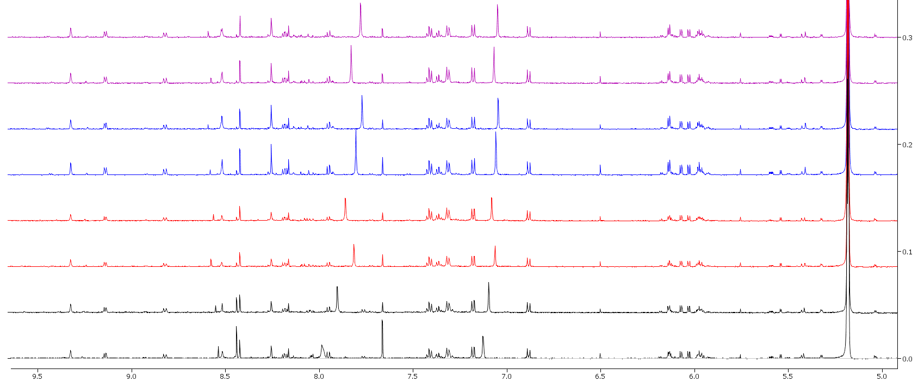
AQUEOUS EXTRACT
Black: Extraction A; Red: Extraction B; Blue: Extraction C; Purple: Extraction D

Slide 3
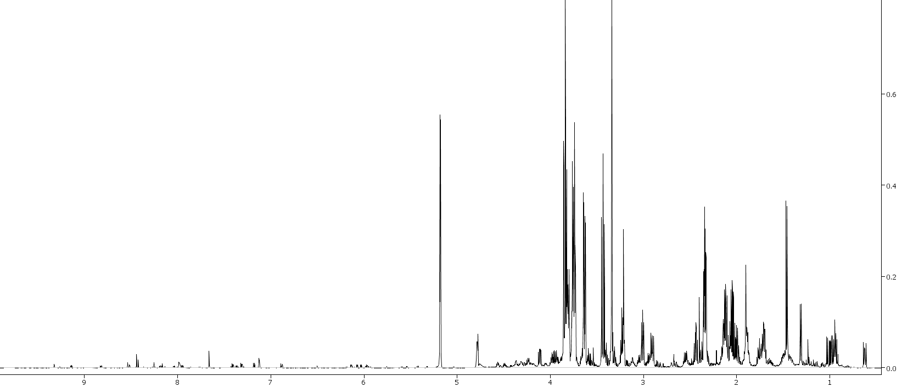
AQUEOUS EXTRACT
M1 (Group A Aqueous)
methanol
trehalose
threonine
glutamine
valine
glycine
glutarate
propylene glycol
succinate
alanine
citrate
carnitine
glutamate
lactate
arginine
isoleucine
lycine
acetone
leucine
serine
glutathione
acetate
tyrosine
UDP-glucose
asaparagine
isobutyrate
phenylalanine
fumarate
proline
aspartate
NAD+
formate

Slide 4
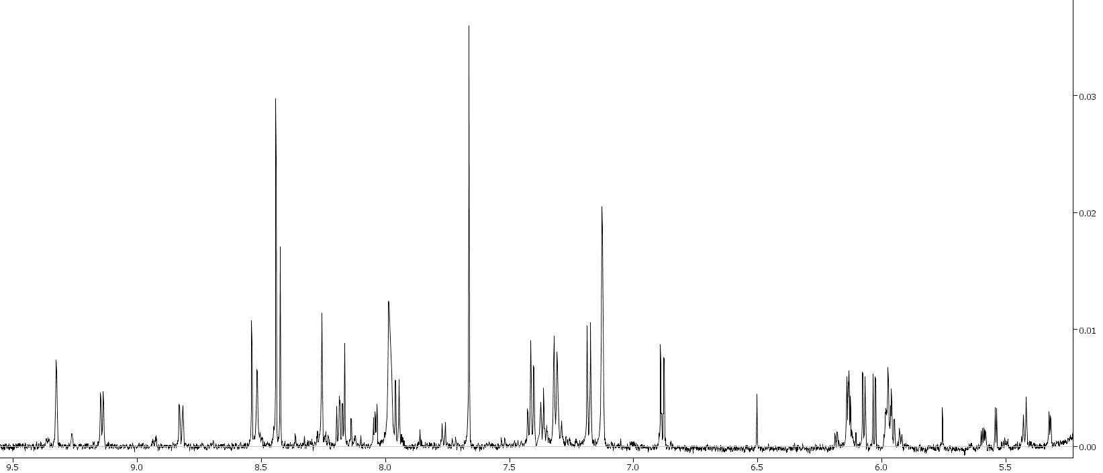
AQUEOUS EXTRACT
formate
phenylalanine
tyrosine
tyrosine
NAD+
UDP-glucose
NAD+
UDP-glucose
NAD+
fumarate
NAD+
NAD+
NAD+
NAD+
UDP-glucose

Slide 5
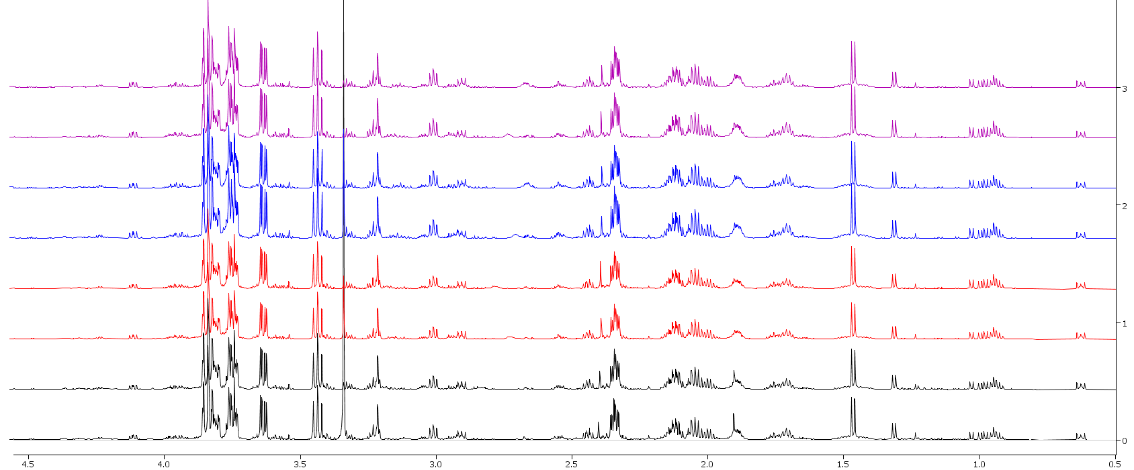
AQUEOUS EXTRACT
Black: Extraction A; Red: Extraction B; Blue: Extraction C; Purple: Extraction D

Slide 6
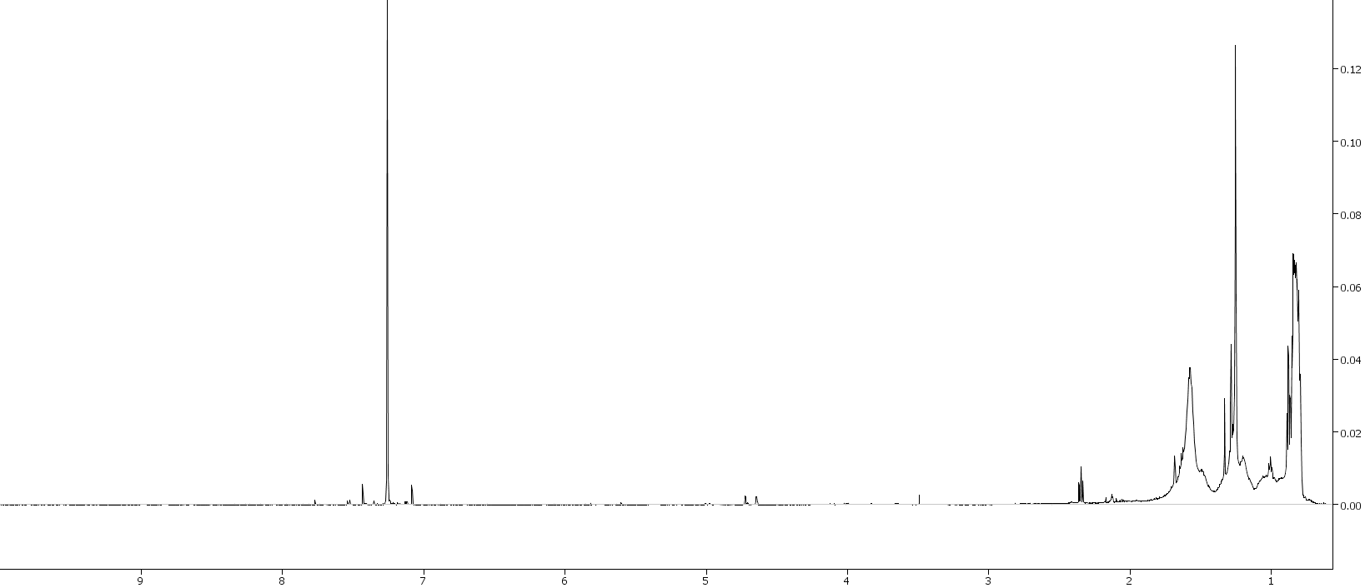
LIPID EXTRACT
L1 (Group A Aqueous)

Slide 7
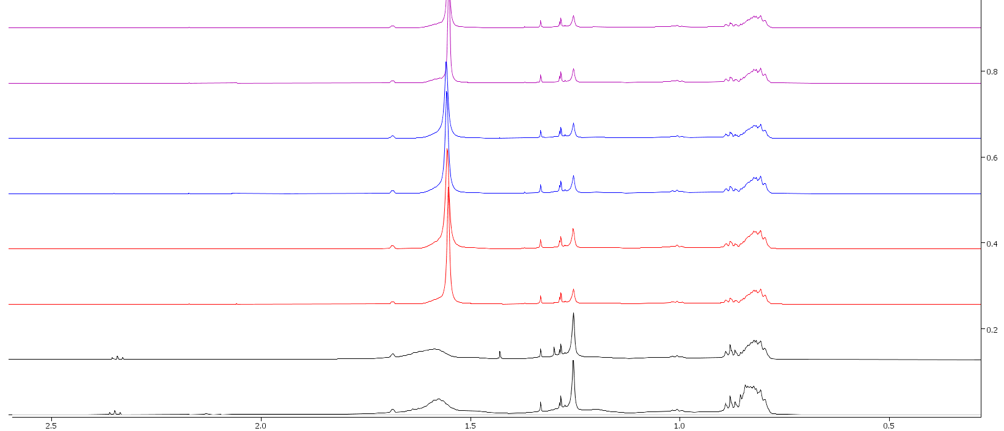
LIPID EXTRACT
Black: Extraction A; Red: Extraction B; Blue: Extraction C; Purple: Extraction D

Slide 8
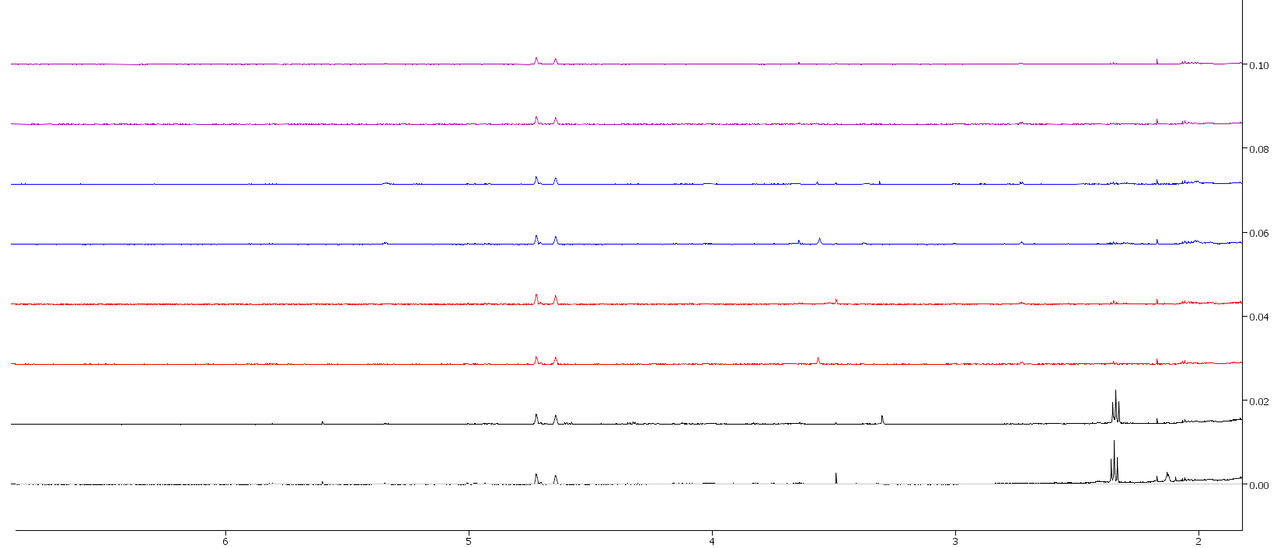
LIPID EXTRACT
Black: Extraction A; Red: Extraction B; Blue: Extraction C; Purple: Extraction D

Slide 9
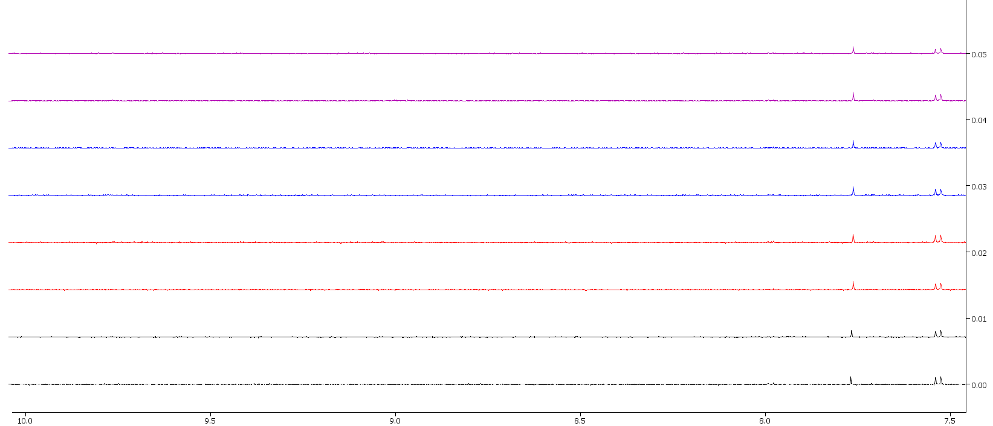
LIPID EXTRACT
Black: Extraction A; Red: Extraction B; Blue: Extraction C; Purple: Extraction D

