Slide 1
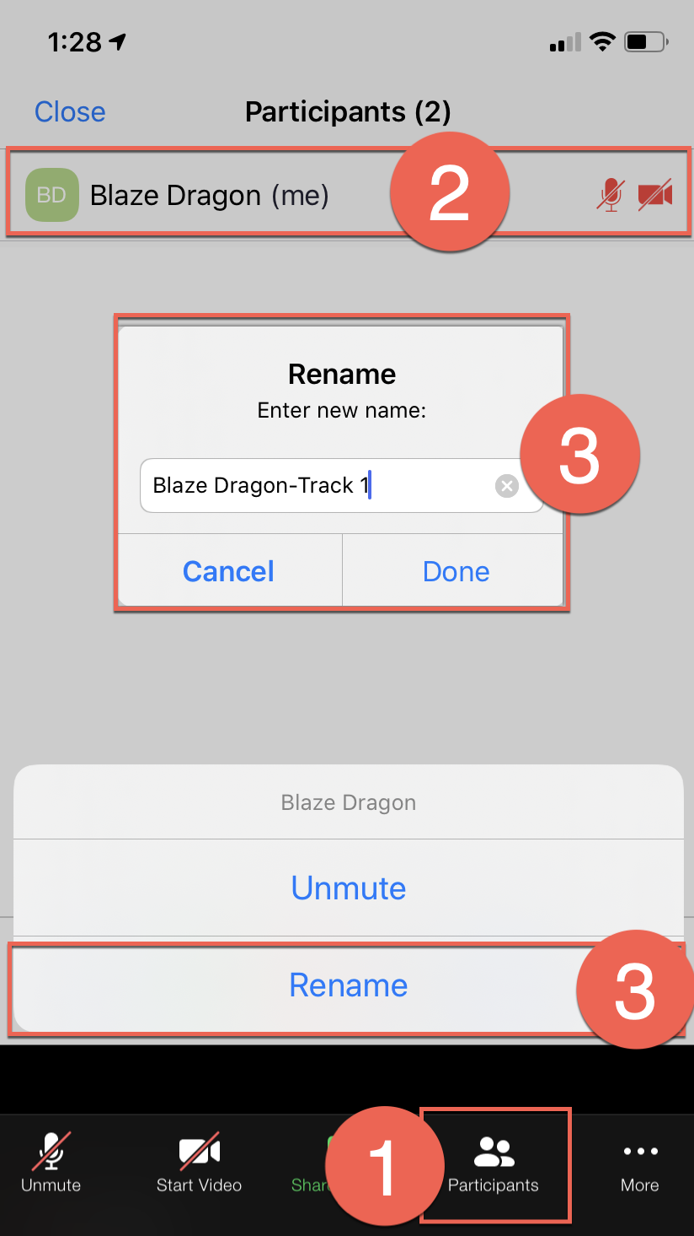
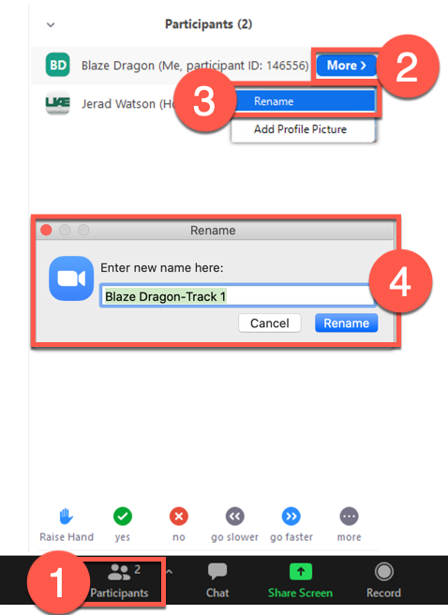
How to Rename yourself in Zoom
Mobile
Desktop
Click Participants
Click your name
Click Rename
Edit and Save

