Slide 1

Intro Slide – Student Background
Presentation Subtitle

Slide 2

Intro Slide –
Classroom Background
Presentation Subtitle

Slide 3

Intro Slide – Gradient
Picture Background
Presentation Subtitle

Slide 4
Executive Summary
Introduction
Objectives
Use this slide for a brief summary of your presentation.
Introduce the topic and give your audience a bit of context so they know what to expect.
Give a brief outline of your basic objectives for the presentation.
What is most important for your audience to know going into the rest of the presentation?

Slide 5
Title and Text
Remember, your slides are a support for your presentation, not a substitute.
A presentation is a live experience carried by the person presenting. Your audience doesn’t need you to read to them.
Keep your text light and visually represent your points wherever possible.
Bullet points are a good option.
They break up blocks of text.
Make it easier to quickly read.
Help you highlight important information.

Slide 6
Title and Text
Know your audience and make sure to tailor your presentation to their needs. Take into account their level of education, familiarity with the subject matter, and background.
If you’re using discipline specific jargon with a cross disciplinary group, be sure to offer definitions so they don’t feel lost.
Keep your core message in mind when crafting your presentation.
Highlight the most important points and think about what pieces of information you most want your audience to take away from your presentation.
Make your message clear and memorable.

Slide 7
Title and Text
Text and talking points should complement one another rather than repeating.
Show more than you tell by using images to describe your subject.
Simplicity is key. Cluttered presentations are distracting to watch.
Keep your core message in mind.
Highlight the most important points and think about what pieces of information you most want your audience to take away from your presentation.
Make your message clear and memorable.
Know your audience and make sure to tailor your presentation to their needs. Take into account their level of education, familiarity with the subject matter, and background.
If you’re using discipline specific jargon with a cross disciplinary group, offer definitions so they don’t feel lost.

Slide 8

Text and Picture Right
Compelling and relevant visuals are crucial to a good presentation.
Look for simple, clean imagery that will draw the audience’s attention without being distracting.
Maintain a consistent look and feel with your imagery.
Make sure the photos you choose complement your chosen color palette, rather than competing with it.

Slide 9

Text and Picture Right

Slide 10
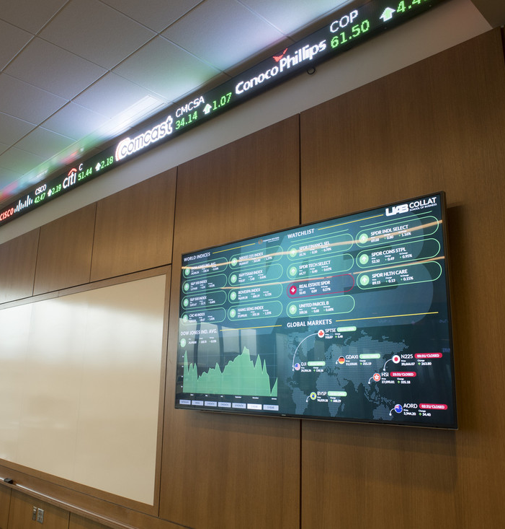
Text and Picture Right

Slide 11
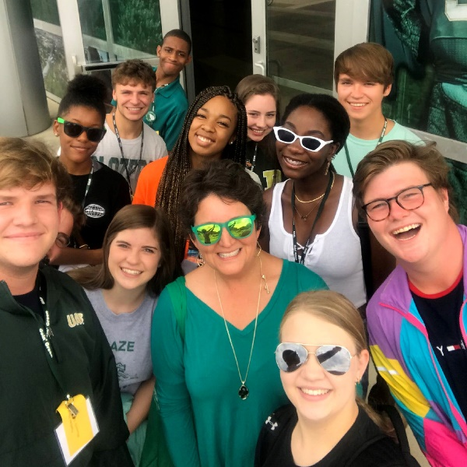
Text and Picture Right

Slide 12

Text and Picture Right

Slide 13

Text and Picture Right

Slide 14

Text and Picture Right

Slide 15
Text and Picture Left
Compelling and relevant visuals are crucial to a good presentation.
Look for simple, clean imagery that will draw the audience’s attention without being distracting.
Maintain a consistent look and feel with your imagery.
Make sure the photos you choose complement your chosen color palette, rather than competing with it.

Slide 16
Text and Picture Left

Slide 17
Text and Picture Left

Slide 18
Text and Picture Left

Slide 19
Text and Picture Right

Slide 20
Text and Picture Left

Slide 21
Text and Picture Left

Slide 22

Text and Picture Horizontal
Compelling and relevant visuals are crucial to a good presentation.
Look for simple, clean imagery that will draw the audience’s attention without being distracting.
Maintain a consistent look and feel with your imagery.
Make sure the photos you choose complement your chosen color palette, rather than competing with it.

Slide 23

Text and Picture Horizontal
Compelling and relevant visuals are crucial to a good presentation.
Look for simple, clean imagery that will draw the audience’s attention without being distracting.
Maintain a consistent look and feel with your imagery.
Make sure the photos you choose complement your chosen color palette, rather than competing with it.

Slide 24
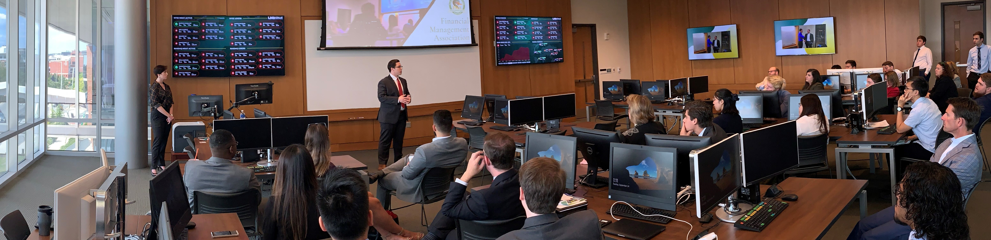
Text and Picture Horizontal

Slide 25

Text and Picture Horizontal

Slide 26
Text and Picture Horizontal
Compelling and relevant visuals are crucial to a good presentation.
Look for simple, clean imagery that will draw the audience’s attention without being distracting.
Maintain a consistent look and feel with your imagery.
Make sure the photos you choose complement your chosen color palette, rather than competing with it.

Slide 27
Section Divider - Green
Divider Subtitle

Slide 28
Section Divider - Watermark
Divider Subtitle

Slide 29

Section Divider –
Student Background
Divider Subtitle

Slide 30

Section Divider –
Picture Background
Divider Subtitle

Slide 31

Meet the Team – 1 Profile
John Doe
Student
Include a short bio and an interesting fact or tidbit of information about this person.

Slide 32





Meet the Team – 5 profiles
John Doe
Jane Doe
Jane Doe
Jane Doe
Jane Doe
Title
Title
Title
Title
Title

Slide 33
Text and Table – Option 1
 | Option 1 |  | Option 2 |  | Option 3
Use this slide to visually represent your data.
Leverage visuals wherever possible. Tables allow your audience to understand data at a glance.
Pull out and highlight the most compelling data points and offer a brief analysis of their relevance.

Slide 34
Text and Table – Option 2
Title 1 |  | The University of Alabama at Birmingham (UAB) | The University of Alabama at Birmingham (UAB) | The University of Alabama at Birmingham (UAB)
Title 2 |  | The University of Alabama at Birmingham (UAB) | The University of Alabama at Birmingham (UAB) | The University of Alabama at Birmingham (UAB)
Title 3 |  | The University of Alabama at Birmingham (UAB) | The University of Alabama at Birmingham (UAB) | The University of Alabama at Birmingham (UAB)
Use this slide to visually represent your data.
Leverage visuals wherever possible. Tables allow your audience to understand data at a glance.
Pull out and highlight the most compelling data points and offer a brief analysis of their relevance.

Slide 35
Text and Table – Option 3
Table 1 Title 1 | Table 1 Title 2
The University of Alabama at Birmingham (UAB) | The University of Alabama at Birmingham (UAB)
Table 2 Title 1 | Table 2 Title 2
The University of Alabama at Birmingham (UAB) | The University of Alabama at Birmingham (UAB)
Use this slide to visually represent your data.
Leverage visuals wherever possible. Tables allow your audience to understand data at a glance.
Pull out and highlight the most compelling data points and offer a brief analysis of their relevance.

Slide 36
Bar Chart and Text – Option 1
Use this slide to visually represent your data.
Leverage visuals wherever possible. Charts and infographics allow your audience to understand data at a glance.
Pull out and highlight the most compelling data points and offer a brief analysis of their relevance.

Slide 37
Bar Chart and Text – Option 2
Use this slide to visually represent your data.
Leverage visuals wherever possible. Charts and infographics allow your audience to understand data at a glance.
Pull out and highlight the most compelling data points and offer a brief analysis of their relevance.

Slide 38
Bar Chart and Text – Option 3
Use this slide to visually represent your data.
Leverage visuals wherever possible. Charts and infographics allow your audience to understand data at a glance.
Pull out and highlight the most compelling data points and offer a brief analysis of their relevance.

Slide 39
Pie Chart and Text – Option 1
Use this slide to visually represent your data.
Leverage visuals wherever possible. Charts and infographics allow your audience to understand data at a glance.
Pull out and highlight the most compelling data points and offer a brief analysis of their relevance.

Slide 40
Pie Chart and Text – Option 2
Use this slide to visually represent your data.
Leverage visuals wherever possible. Charts and infographics allow your audience to understand data at a glance.
Pull out and highlight the most compelling data points and offer a brief analysis of their relevance.

Slide 41
Pie Chart and Text – Option 3
Use this slide to visually represent your data.
Leverage visuals wherever possible. Charts and infographics allow your audience to understand data at a glance.
Pull out and highlight the most compelling data points and offer a brief analysis of their relevance.

Slide 42
Line Chart and Text – Option 1
Use this slide to visually represent your data.
Leverage visuals wherever possible. Charts and infographics allow your audience to understand data at a glance.
Pull out and highlight the most compelling data points and offer a brief analysis of their relevance.

Slide 43
Line Chart and Text – Option 2
Use this slide to visually represent your data.
Leverage visuals wherever possible. Charts and infographics allow your audience to understand data at a glance.
Pull out and highlight the most compelling data points and offer a brief analysis of their relevance.

Slide 44
Line Chart and Text – Option 3
Use this slide to visually represent your data.
Leverage visuals wherever possible. Charts and infographics allow your audience to understand data at a glance.
Pull out and highlight the most compelling data points and offer a brief analysis of their relevance.

Slide 45
SWOT Analysis
Strengths
Opportunities
Weakness
Threats
Positive attributes of your project, both tangible and intangible that are within your control.
Positive external factors that represent reasons your project will be successful, relevant, and useful.
Facets of your project that are within your control but weaken its credibility, feasibility, or standing.
Potential threats to your project. What obstacles do you anticipate popping up?

Slide 46
PEST Analysis
Political
Influences related to politics and the government. Laws, taxes, and inflation rates.
Economic
Unemployment rates, economic growth, and interest rates.
Social
Population growth, environmental, cultural and demographic factors.
Technological
Technological developments and offerings.

Slide 47
Gantt Chart
Task
Task
Task
Task
Task
Task
Task
Task

Slide 48
UAB Brand
Assets
The following slides contain brand assets for quick access (copy & paste). You can find more at uab.edu/toolkit.

Slide 49
Colors
UAB Green
PMS: 3425
CMYK: 100 0 78 42
RGB: 30 107 82
Hex: #1E6B52
Blaze
PMS: 109
CMYK: 0 15 100 0
RGB: 255 209 0
Hex: #ffd400
Core Palette
A single color communicates meaning almost instantaneously, and color is a key factor in brand recognition. Color defines us, unifies us, rallies us.
The official university colors are green and white, with gold traditionally used as an accent color.
Dark Green
PMS: 350
CMYK: 80 43 83 42
RGB: 41 81 53
Hex: #295135
Gold
PMS: 7503
CMYK: 34 35 68 4
RGB: 170 151 103
Hex: #aa9767
Apple Green
PMS: 376
CMYK: 50 0 100 0
RGB: 128 188 0
Hex: #80bc00
Stone
PMS: Cool Gray 9
CMYK: 0 0 0 60
RGB: 128 130 133
Hex: #808285

Slide 50



Logos
Standard Logo
The standard UAB logo (monogram + wordmark) incorporates two graphic elements: the UAB monogram and
“The University of Alabama at Birmingham” wordmark.
Centered Logo
The centered logo can be used when space is limited or when the logo must appear in a grouping with other logos, such as with sponsorships or partnership listings.
Extreme Horizontal Logo
The extreme horizontal logo can be used when space is limited or when the logo must appear in the tight spaces of screens on digital devices.
UAB Watermark
The circular watermark may be used only where embroidery patches traditionally have been used on uniforms such as lab coats, smocks, and scrubs. Where required, metallic medallions, coins, certificates, and lapel pins also may use a circular configuration. The watermark should be paired with the full UAB logo where possible.

Slide 51

























Icons - Color

Slide 52

























Icons – Black & White

Slide 53
Icons - Green

Slide 54
Text Boxes
Title
Title
Title
Text
Text
Text
1
1
1

Slide 55
Text Boxes - 4
Text
Text
Text
Text

Slide 56
Text Boxes - 3
Text
Text
Text

Slide 57
Text Boxes – 1 Primary + 2 Secondary
Text
Text
Text
1

Slide 58
Text Circles – 1 Primary + 2 Secondary

Slide 59
Callout Boxes and Elements

Slide 60
UAB is the Top Young University in the U.S. and among the top 10 globally in the Times Higher Education World University Rankings.
- 2018, Times Higher Education

Slide 61
In U.S. News & World Report “Best Online Colleges” 2021, Collat's three graduate programs ranked among the top in the nation, including the #13 Master’s in Management Information System program.
- 2021, U.S. News & World Report

Slide 62

Collat enrolled 3,416 students in fall 2020, a 23% increase over 2015. 77% of Collat students are undergrads.
- 2021, UAB Institutional Effectiveness & Analysis

Slide 63
The Sales Education Foundation recognized Collat's Professional Sales Certificate Program as a "Top University Sales Program" in 2020.
- 2020, Sales Education Foundation

Slide 64
The Collat School of Business ranked #48 on The Princeton Review's prestigious list of Top Graduate Schools for Entrepreneurship.
- 2020, The Princeton Review

Slide 65
Big statement or important quotation.
Author

Slide 66
Big statement or important quotation.
Author

Slide 67
Big statement or important quotation.
Author

Slide 68
Big statement or important quotation.
Author

Slide 69
Big statement or important quotation.
Author

Slide 70

Big statement or important quotation.
Author

Slide 71


Storyboard – 4 Pictures

Slide 72






Storyboard – 6 Pictures

Slide 73




Storyboard – 8 Pictures

Slide 74
Contact us – Option 1
Phone
Address
Email
Website

Slide 75
Contact us – Option 2
Phone
Address
Email
Website

Slide 76
Thank you!

Slide 77
Thank you!

